Slide 1
Phone free in the car?
Basic 12 Unit 10B

Slide 2
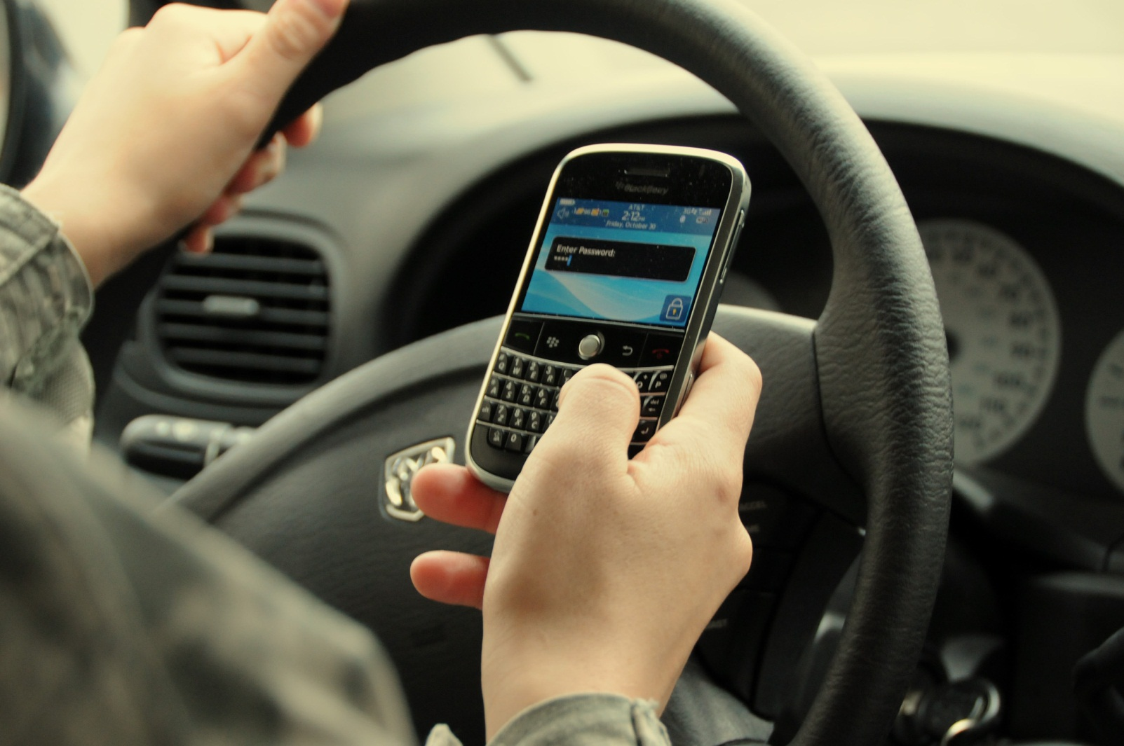

Slide 3
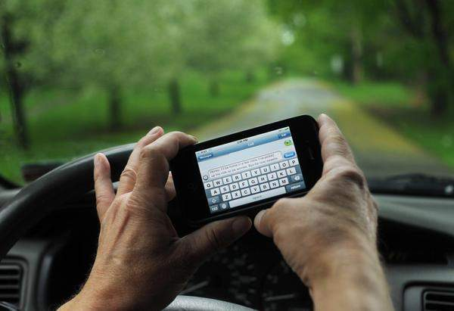

Slide 4
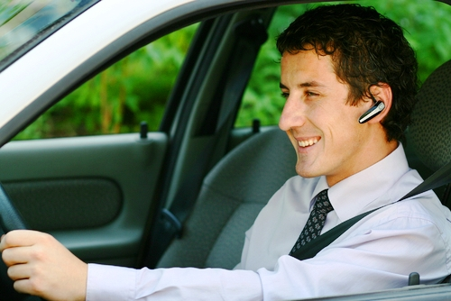
http://www.youtube.com/watch?v=dmDdvkh4jo0

